Slide 1

QR Code For the Slide and Website Link
https://github.com/Yu2413/Python-Powerhouse-Diverse-Applications-and-Solutions/tree/main/QGIS%20PowerPoint

Slide 2

GIS and Software Programming (With a focus on Python, and JavaScript)
By Gary Yu (Master’s in Geographic Information Systems Technology Student at OSU)

Slide 3

Table of Contents
GIS Overview (1 slide)
Programming Overview (1 slide)
GIS History (1 slide)
History of Programming (Python, and JS) (1 slide)
A Cluster of GIS Software (1 slide)
A Tale of Two Programming Languages (Python and JavaScript) (1 slide)
How to integrate GIS Software in Python (3 Slides)
How to integrate GIS Software in JS (4 Slides)

Slide 4
GIS Qualitative/Non-Technical Information TLDR Overview
Geographic Information System (GIS) is the use of computers to manage (display, store, analyze, and manipulate) geographic data. (I made this)
Most academics believe first true GIS was made in Ottawa Canada by Roger Tomlinson (Father/Creator of GIS) in 1963, Esri (ArcGIS software company) founded in 1969.
Examples of GIS everyday applications includes Google Earth, Apple Maps, Google Maps, Pokémon Go, and the Covid-19 Infection Map at Penn State during Covid-19.

Slide 5
Technical Overview: TLDR of this entire Presentation (Google Gemini)
You can enable Python(Py), and JavaScript(JS) to interact with geographic data, and GIS software with a wide variety of integration software with python, and JavaScript in the form of
Python: ArcPy, ArcGIS API for Python, Google Earth Engine (EE API), Plotly/GeoPlot, Folium, Rtree, Xarray/RioXarray, OSMnx, PySAL, PyProj, GeoPandas, Shapely, Fiona, Rasterio, GDAL/OGR, PyQGIS, and others
There are three types: Commercial/Enterprise (ArcGIS related), Specialized & Visualization (Folium, Leafmap, Contextily, OSMnx, and Cartopy), and Open-Source (GeoPandas, Shapely, Rasterio, Fiona, GDAL/OGR, and Pyproj)
JavaScript: ArcGIS Maps SDK for JavaScript, Turf.js, Leaflet, OpenLayers, Mapbox GL JS, MapLibre GL JS, deck.gl, CesiumJS, and others.
Almost of these are Mapping and Visualization Libraries except for the Geospatial Analysis Package of Turf.js
GIS Software includes ArcGIS Pro, QGIS, Global Mapper, PostgreSQL/PostGIS, AutoCAD Map 3D, Google Earth Pro.

Slide 6
The History of GIS (ESRI)
Pre-GIS: Earliest Maps were stone tablets, and then various materials for maps used for exploring, navigation, planning, and strategy
Earliest Spatial Analysis: John Snow on Cholera cases to single water source (1854)
GIS: 1960s computers with IBM computerizing geography, Geographer Roger Tomlinson creates first GIS/system for inventorying of natural resources, Esri founded in 1969(ArcGIS)
First Landsat Satellite: 1972, First: GPS Satellite: 1978, 1982 GRASS: First open-source GIS by US Army Corp of Engineers, First GPS for cars in 1986: Mazda’s Eunos Cosmo
GIS in 1990s: 1991: GIS goes Mainstream with media, 2004: National Geospatial Agency
GIS in 2000s: 2005: Google Maps, 2006: AWS:, 2007: iPhone, 2009: Data.gov
GIS in 2010s+: ArcGIS Online released (Esri), 2018: AI and GIS (GeoAI), 2020: Covid-19 Maps (John Hopkins University)

Slide 7
The History of Programming/Computing (Wirth)
Late 1950s - Large Computers for research institutions, and universities made available mainly in engineering and natural sciences and some businesses
1957 - First widely known language, Fortran by IBM, Algol (1958), Cobol(DOD) (1962)
1965 - Dijkstra writes his famous Notes on Structured Programming
1973 - C from UNIX, | 1975 Micro Computers (Commodore, Tandy, Apple, much later IBM) 1975 Personal Workstation | Ada 1977 – 1982 (DOD), C++ (1985)
1980 - Object-oriented programming (OO): Smalltalk (1980), Object-Pascal (1985), C++ (1985), Oberon (1988), Java (1995) and C# (Microsoft 2000).
1990s – Popularization of Open Source, Python (1991), JavaScript (1995)
“Reiser’s “law”: “Software is getting slower faster than hardware is getting faster”.”

Slide 8
A Cluster of GIS Software (“Geographic Information System Software”)
Open Source: Desktop GIS: QGIS, GRASS GIS, gvSIG, ILWIS, JUMP GIS, MapWindow GIS, uDig, SAGA GIS, Generic Mapping Tools, FalconView, Kalypso, TerraView, Whitebox GAT. Web map servers: GeoServer, MapGuide Open Source, Mapnik, MapServer. Spatial database management systems: PostGIS, ArangoDB, SpatiaLite, TerraLib, OrientDB Software development frameworks and libraries (for web applications): GeoBase, OpenLayers, Leafletjs, xeokit Software development frameworks and libraries (non-web): GeoTools, GDAL, Orfeo toolbox Cataloging application for spatially referenced resources: GeoNetwork opensource: pycsw Commercial: High Market Share: Esri: ArcGIS, ArcMap, ArcSDE, ArcIMS, ArcWeb services, ArcGIS Server | Autodesk: AutoCAD | Bentley: MicroStation | ENVI | Hexagon AB | MapInfo Corporation: MapInfo Professional | GE: Smallworld Smaller Market Share: Cadcorp, Caliper, Conform, Dragon/ips, Geosoft, GeoTime, Global Mapper, Golden Software Kongsberg Gallium Ltd., MapDotNet, Manifold System, GfK, Remoteview, SuperMap Inc., TerrSet, TNTmips GIS SaaS: ArcGIS Online, CartoDB, Google Earth Engine, Mapbox, MapTiler, Maptitude GIS PaaS: ArcGIS Online, FME Cloud, Google Maps JavaScript, Here Maps JavaScript, Microsoft Bing Geocode Dataflow API, US Census Geocoder GIS DaaS: ArcGIS Online, Google Maps, Apple Maps, Here Maps, Microsoft Bing Maps, OpenStreetMap Spatial DBMS: Boeing's Spatial Query Server, IBM Db2, Informix, MySQL, MS SQL Server, Oracle Spatial, SAP HANA, TeraData, VMDS

Slide 9
A Tale of Two Programming Languages
Python: (Python Software Foundation)
Python is an interpreted, object-oriented, high-level programming language spearheaded by Guido van Rossum.
Python's simple, easy to learn syntax emphasizes readability which reduces the cost of program maintenance.
Python supports modules and packages, which encourages program modularity and code reuse.
The Python interpreter and the extensive standard library are available without charge for all major platforms and can be freely distributed.
JavaScript: (MDN Contributors)
JavaScript (JS) is a lightweight interpreted (or just-in-time compiled) programming language with first-class functions.
Generally considered most well-known as the scripting language for Web pages
Also used by Node.js, Apache CouchDB and Adobe Acrobat.
JavaScript is a prototype-based, garbage-collected, dynamic language, supporting multiple paradigms such as imperative, functional, and object-oriented.

Slide 10
ArcPy (“A Quick Tour of ArcPy—ArcGIS pro | Documentation”)
ArcPy is a Python site package that provides a useful and productive way to perform geographic data analysis, data conversion, data management, and map automation with Python.
This package provides a rich and native Python experience offering code completion (type a keyword and a dot to get a pop-up list of properties and methods supported by that keyword; select one to insert it) and reference documentation for each function, module, and class.
Only available with an ArcGIS Pro subscription.
Charts (arcpy.charts) | Data Access (arcpy.da) | Geocoding (arcpy.geocoding) | Image Analysis (arcpy.ia) | Mapping (arcpy.mp)
Metadata (arcpy.metadata) | Network Analyst (arcpy.nax and arcpy.na) | Sharing (arcpy.sharing)
Spatial Analyst (arcpy.sa) | Utility Network (arcpy.un) | Workflow Manager (arcpy.wmx)

Slide 11
Py and JS | QGIS 1
Requirements
Beginner plus understanding of python and JavaScript
Microsoft Windows 11 (Maybe 10 can work) (I didn’t try this on MacOS or a Linux Distro yet)
Need to install QGIS (It’s Free)
Need some basic understanding of CSVs or comma separated value files
Some basic understanding of maps (latitude, longitude)
Maps are often made up of layers of information, one layer for example may have rivers, another may have cities, etc.
On QGIS go to View -> Panels -> enable browser, layers, python console, and On the python console near the green play button click on Show Editor

Slide 12
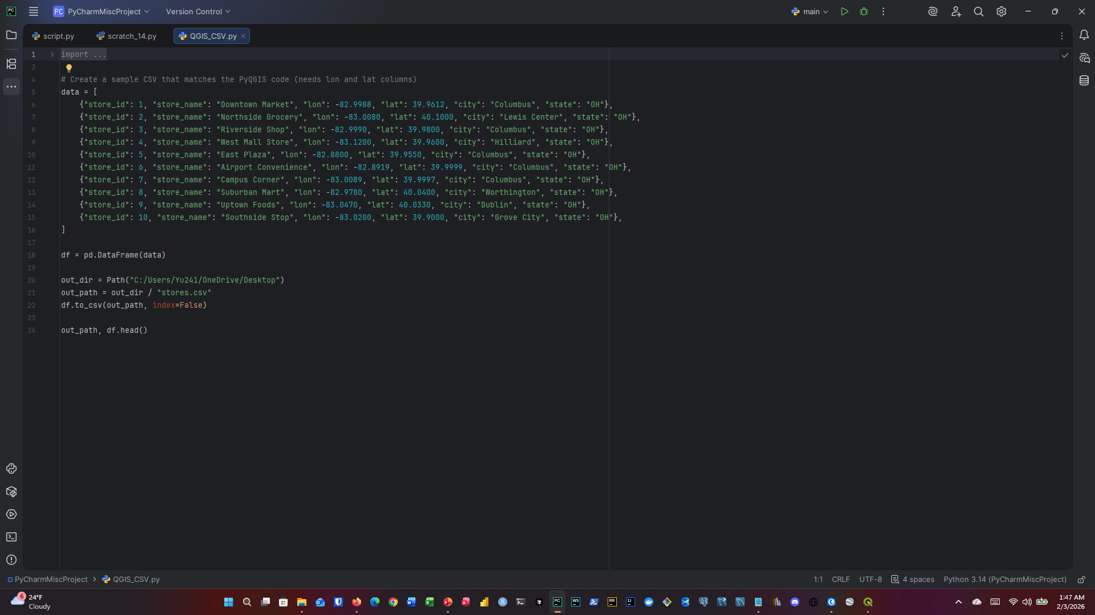
Py | QGIS 2
CSV File Generation(Syntex also in my GitHub) | Or just download it from my GitHub

Slide 13
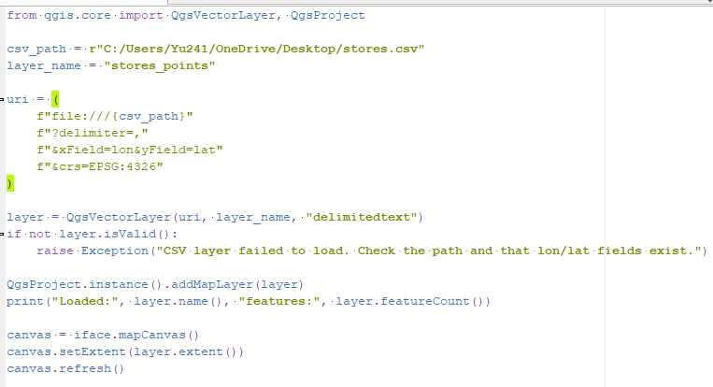
Py | QGIS 3
Note: Generally, do this in QGIS
Lat = latitude
Lon = longitude
For CSV path use the / not \ that comes with copy from path

Slide 14
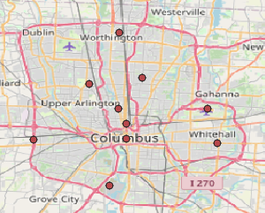
Py | QGIS 4

Slide 15
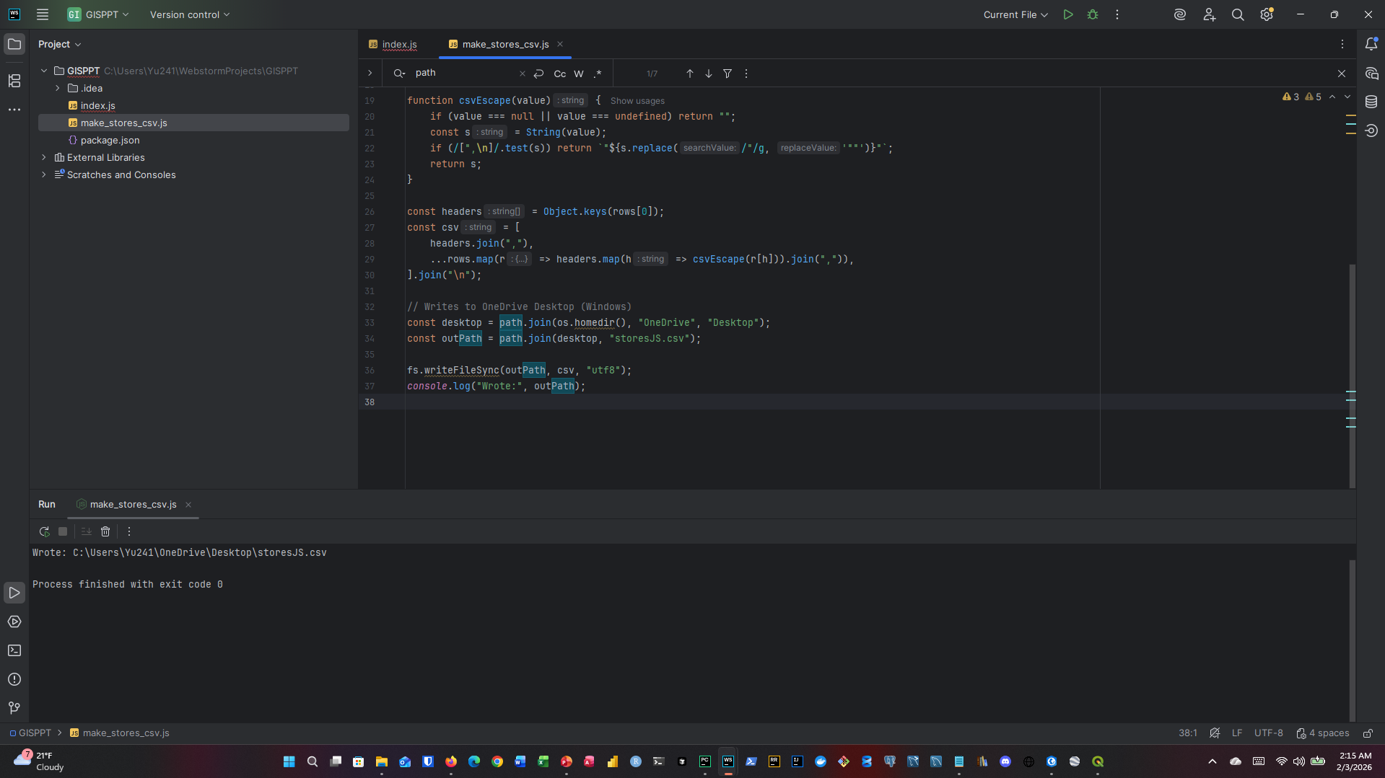
JS | QGIS 1 JS CSV File Generation(Syntex also in my GitHub) | Or just download it from my GitHub

Slide 16
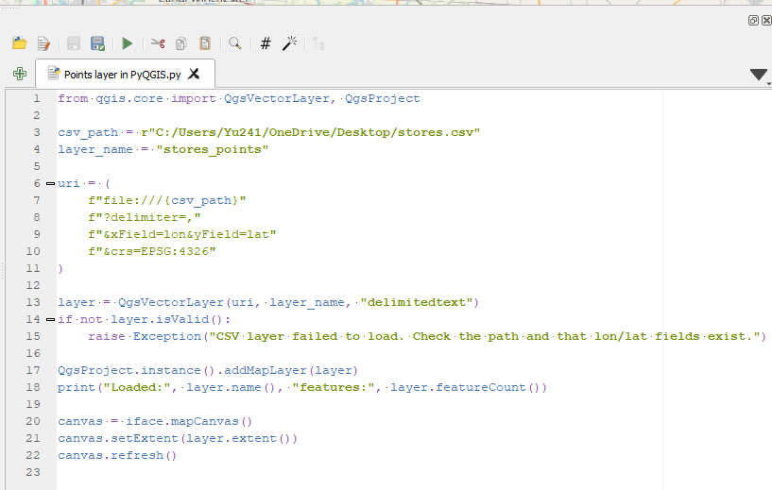
JS | QGIS 2 with the Help of Python in QGIS

Slide 17
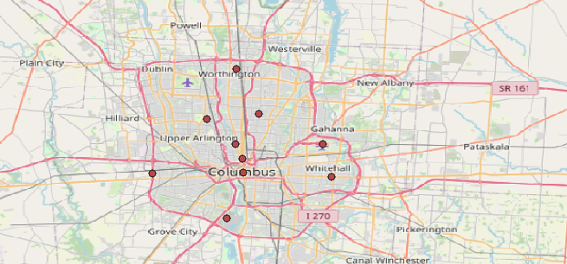
JS | QGIS 3

Slide 18
Works Cited
ESRI. “History of GIS | Early History and the Future of GIS - Esri.” Esri.com, ESRI, 2019, www.esri.com/en-us/what-is-gis/history-of-gis. Accessed 30 Jan. 2026.
“Geographic Information System Software.” Wikipedia, Wikipedia, 24 Mar. 2022, en.wikipedia.org/wiki/Geographic_information_system_software. Accessed 30 Jan. 2026.
Wirth, Niklaus. “A Brief History of Software Engineering.” IEEE Annals of the History of Computing, vol. 30, no. 3, July 2008, pp. 32–39, inf.ethz.ch/personal/wirth/Miscellaneous/IEEE-Annals.pdf, https://doi.org/10.1109/mahc.2008.33.
Python Software Foundation. “What Is Python? Executive Summary.” Python, 2025, www.python.org/doc/essays/blurb/.
“A Quick Tour of ArcPy—ArcGIS pro | Documentation.” Arcgis.com, 2026, pro.arcgis.com/en/pro-app/3.4/arcpy/get-started/a-quick-tour-of-arcpy.htm. Accessed 4 Feb. 2026.

Slide 19
Questions?

